Slide 1
CMP5329 Cyber Security
AAA and Access Control
PhD. Ngoc-Tu Nguyen
tunn@uit.edu.vn

Slide 2
Outline
Network secure protocols
Authentication;
Key agreemen;
IPSec; SSL/TLS; SSH; Kerberos
Notes:
Cipher=a secret system of writing;

Slide 3
Security goals
Goals
Cipher systems
- Symmetric (DES, AES)
- Asymmetric (RSA, ECC, CRYSTALS-KYBER)
Confidentiality
Privacy
Integrity
Hash functions
Message authentication code (MAC)
Digital signature (digital certificate)
Authentication
Non-repudiation (Accountability)
Access control
RBAC, ABAC, PBAC
Availability

Slide 4








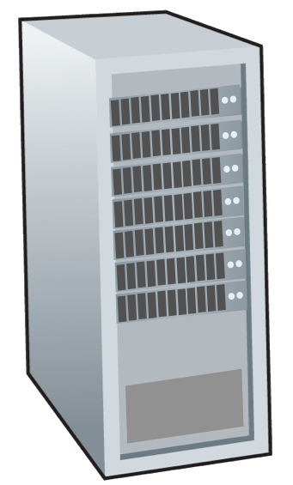







Motivations
Network devices:
End devices
Intermediate devices
mobile network
national or global ISP
Communication links
fiber, copper, radio
transmission rate: bandwidth
local or regional ISP
Internet
home network
content
provider
network
Network protocols
How to secure storage and exchange data?
datacenter
network
Send?
Receiver?
Storage?
enterprise
network

Slide 5
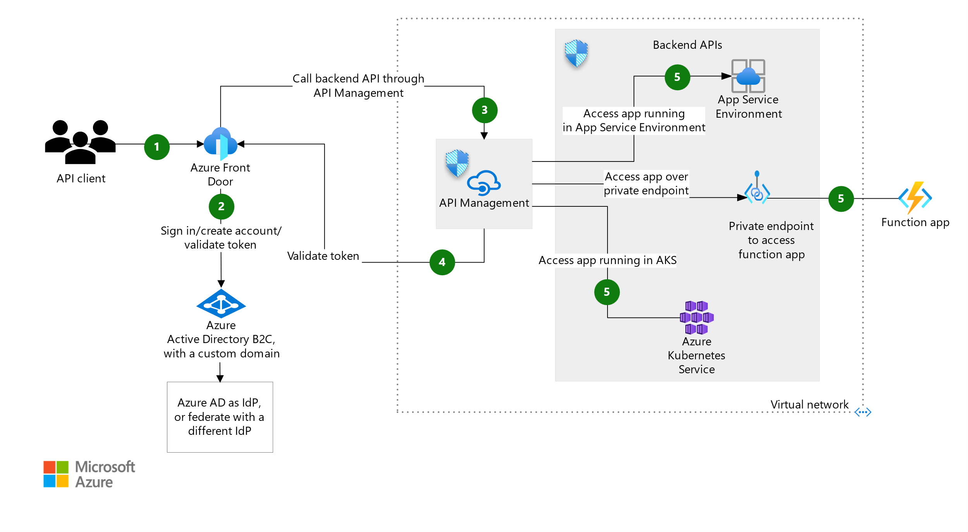
Authentication and Authorization
Notes:
authentication factors= Các yếu

Slide 6
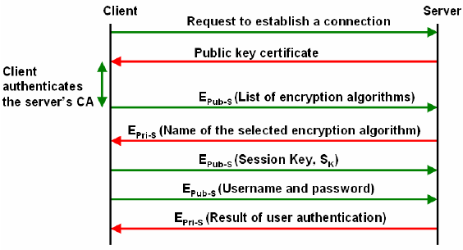
Network secure protocols
Example: SSH protocols
Why?
Notes:
Cipher=a secret system of writing;

Slide 7
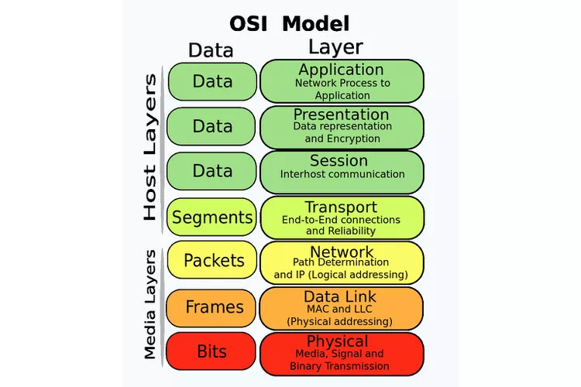
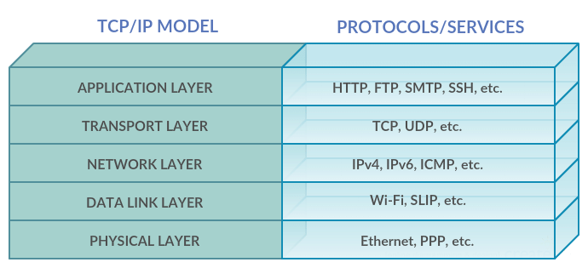
Motivations

Slide 8








Motivations
H_{a}
M
(Service/
Microservices)
(Service/
Microservices)
Application
transport
network
link
physical
H_{a}
M
application
transport
network
link
physical
message
M₁ | M₂ | … | M_{n}
M₂ | M₁ | … | M_{n}
segment
H_{t}
M_{i}
…
H_{t} M_{i}
datagram
frame
H_{n} | H_{t} | M_{i}
H_{n} H_{t}
M_{i}
H_{l} | H_{n} | H_{t} | M_{i}
_{Hl} | _{Hn} | _{Ht} | _{Mi}
source
destination

Slide 9
Deployment network secure protocols
Logical (Software)‏
Physical (Hardware)‏
Application
Web, Email
Transport Layer
TCP, UDP
Network Layer
IP
Data Link Layer
Ethernet, 802.11
Physical Layer

Slide 10
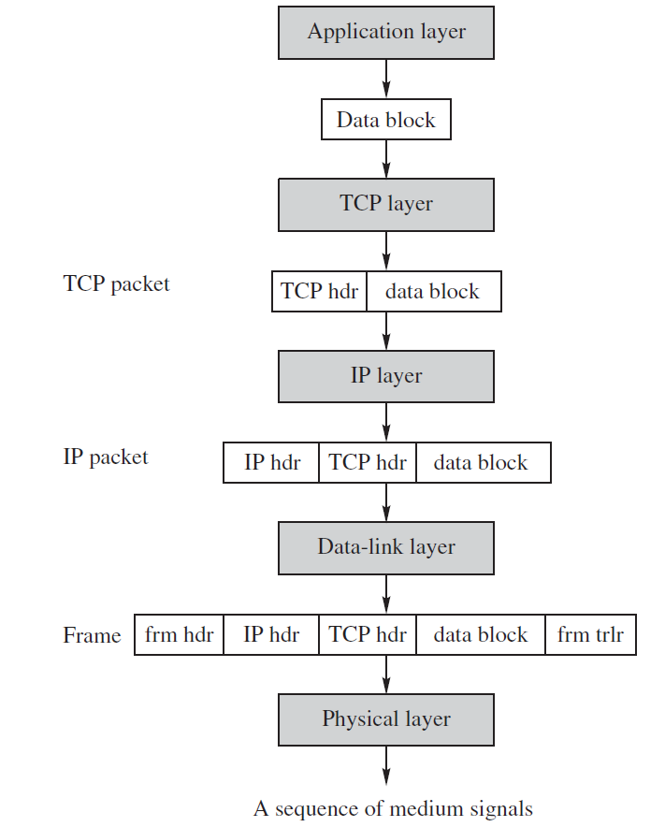
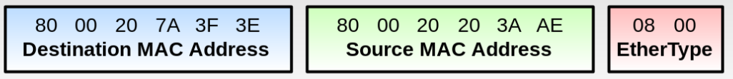

Deployment network secure protocols
PGP and S/MIME Email Security Protocols
SSL/TLS, SSH protocol
Ipsec, VPN protocols
WEB, WPA, WPA2, WPA 2 …
Notes:
frm trlr =redundancy check (CRC) trailer;

Slide 11
What Are the Pros and Cons?
Application Layer
Provides end-to-end security protection
Intermediate nodes need not to decrypt data or check for signatures
Attackers may analyse traffic and modify low-level headers
Transport Layer
Provides security protections for TCP packets
No need to modify any application programs
Attackers may analyse traffic via IP headers

Slide 12
What Are the Pros and Cons?
Network Layer
Provides node-to-node security protection
Transport mode: Encrypt payload only
Tunnel mode: Encrypt both header & payload; need a gateway
No need to modify any application programs
Data-link Layer
Provides security protections for frames
No need to modify any application programs
Traffic analysis would not yield much info

Slide 13
SSH protocol
SSH Connection:
Sets up multiple channels for different applications in a single SSH connection
SSH User Authentication:
Authenticate user to server
Using password or PKC
SSH Transport
Handles initial setup: server authentication, and key exchange
Set up encryption and compression algorithms
SSH Connection
SSH User Authentication
Application Layer
SSH Transport
TCP
IP
Data Link
Physical
SSH architecture

Slide 14
SSH protocol
Notes:
14

Slide 15
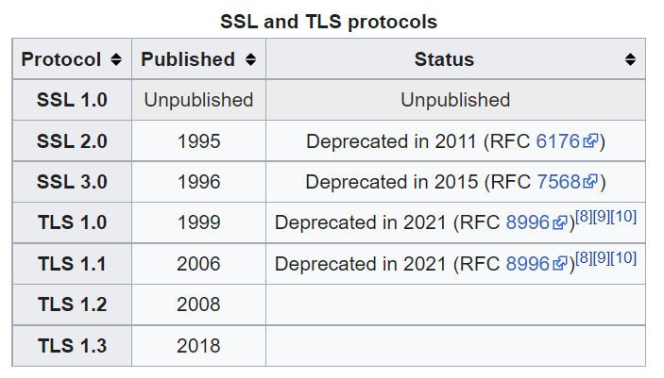
SSL/TLS
Secure Socket Layer Protocol (SSL)
Designed by Netscape in 1994
https://en.wikipedia.org/wiki/Transport_Layer_Security

Slide 16
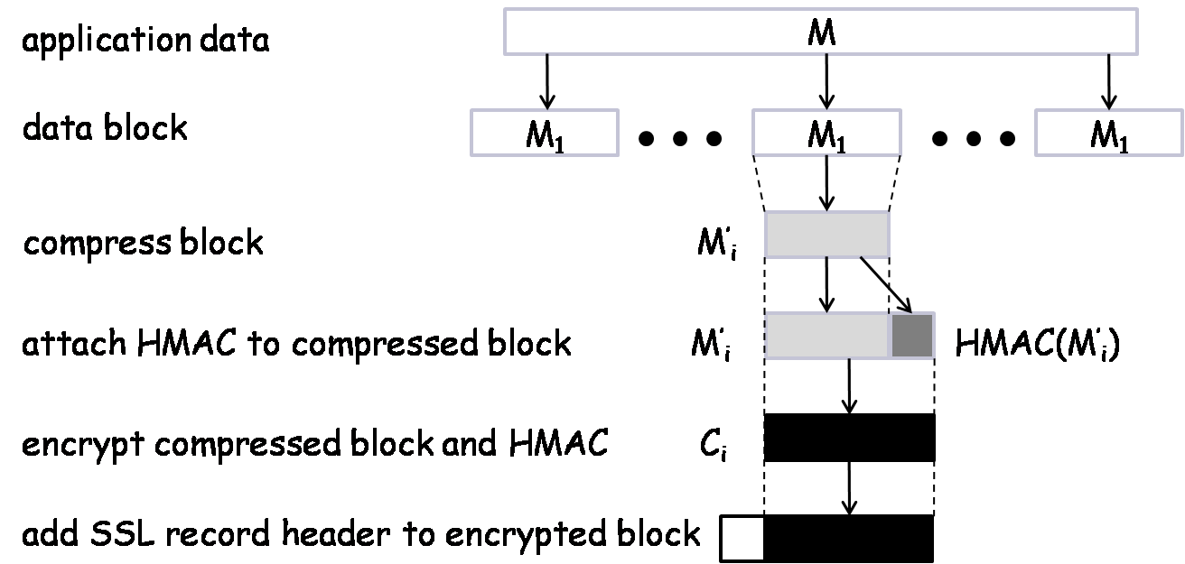
TLS Record Protocol Diagram
SSL record protocol

Slide 17
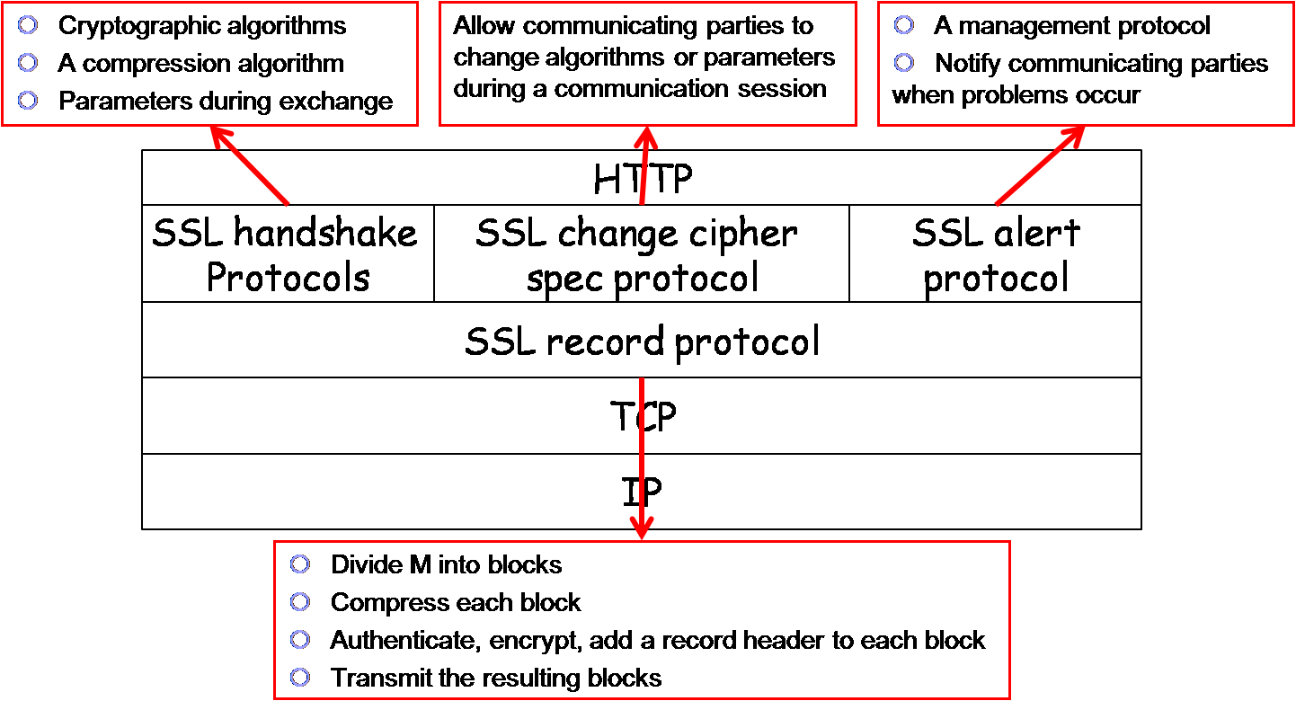
TSL Structure

Slide 18
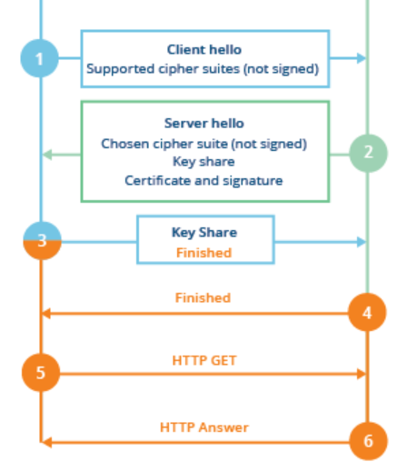
TSL protocol v 1.2
Client
Server
(EC)DHE

Slide 19
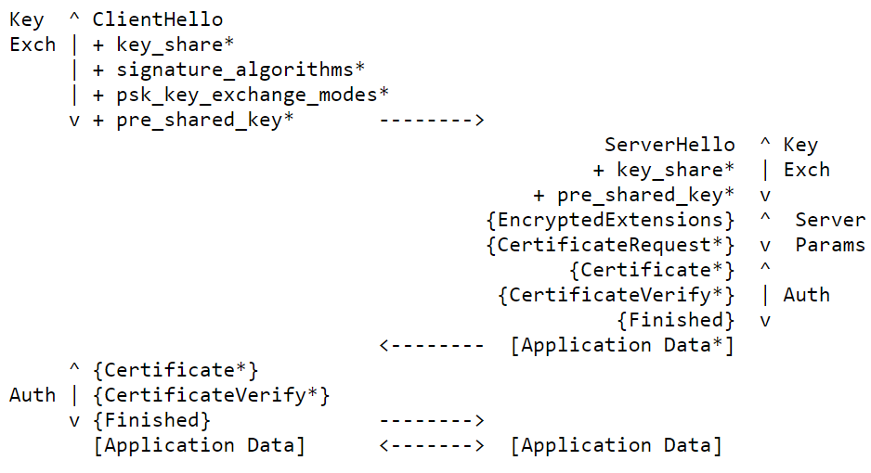
TSL protocol v 1.3
Client
Server
https://datatracker.ietf.org/doc/html/rfc8446

Slide 20
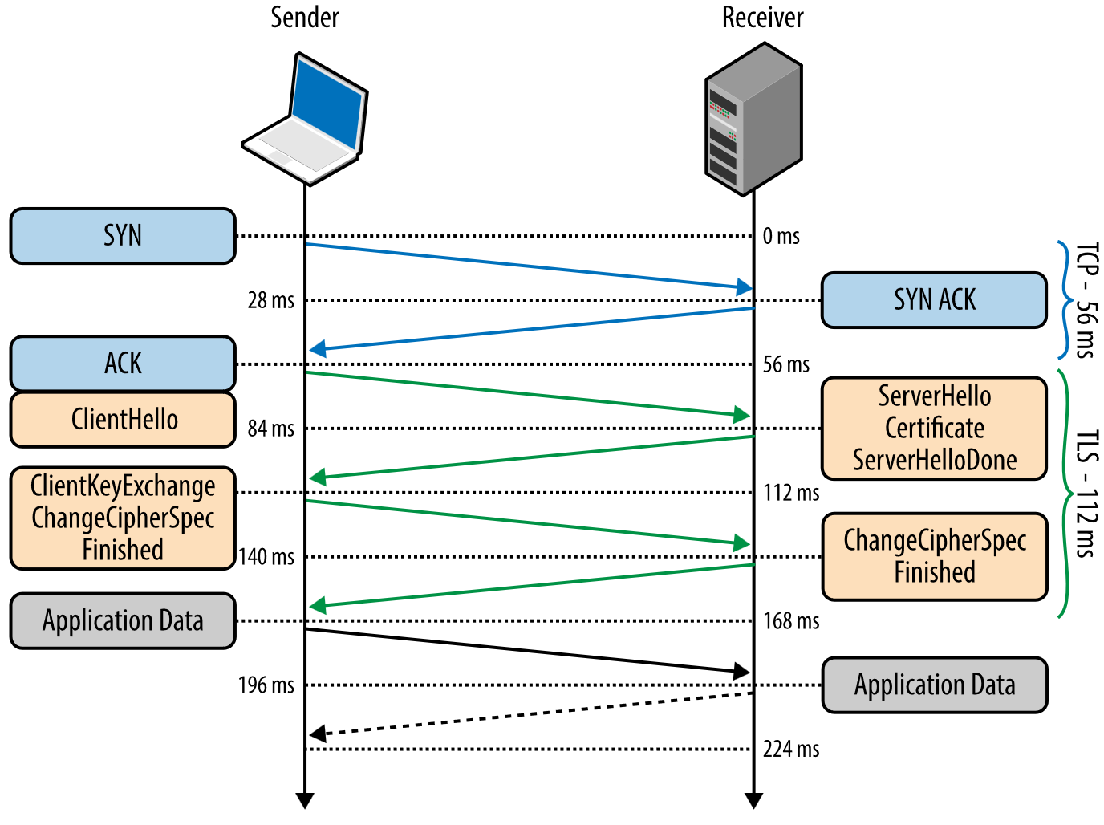
TSL protocol v 1.2
Authentication: digital certificate;
Key agreement(ex. ECDH)
Cryptographic algorithm negotiation (ciphers, MAC)

Slide 21
TSL protocol v 1.3
Client
Server
https://datatracker.ietf.org/doc/html/rfc8446

Slide 22
IPsec: Network-Layer Protocol
IPsec encrypts and/or authenticates IP packets
It consists of three protocols:
Authentication header (AH)
To authenticate the origin of the IP packet and ensure its integrity
To detect message replays using sliding window
Encapsulating security payload (ESP)
Encrypt and/or authenticate IP packets
Internet key exchange (IKE)
Establish secret keys for the sender and the receiver
Runs in one of two modes:
Transport Mode
Tunnel Mode (requires gateway)‏

Slide 23
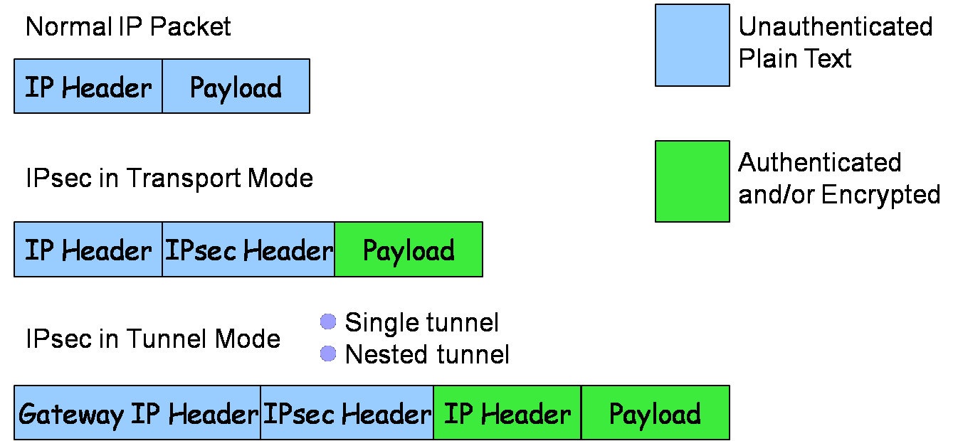
IPsec Packet Layout
H_{t}
M_{i}
segment

Slide 24
IPsec Transport Mode
Host-to-host (end-to-end) security:
IPsec processing performed at endpoints of secure channel.
Endpoint hosts must be IPsec-aware.
Header
Payload
Header
Payload
IP datagram
network
IP datagram

Slide 25
IPsec Tunnel Mode
Header
Payload
Header
Payload
Inner IP datagram
Inner IP datagram
Security
Gateway
network
Security
Gateway
Outer
Header
Header
Payload
Outer
Header
Header
Payload

Slide 26
Remote Host to Internal Server
Remote host has Internet access to gateway, then gains access to server behind gateway.
Traffic to server protected in inner tunnel.
Outer tunnel protects inner traffic over Internet.
Outer Tunnel
Inner tunnel
Internet
Local network
remote
host
Security
Gateway
server

Slide 27
IPsec Security Associations
Client
Server
SA
If Client wants to establish an IPsec connection with Server, the two parties must first negotiate a set of keys and algorithms
The concept of security association (SA) is a mechanism for this purpose
An SA is formed between an initiator and a responder, and lasts for one session
An SA is for encryption or authentication, but not both.
If a connection needs both, it must create two SAs, one for encryption and one for authentication

Slide 28
SA Components
Three parameters:
Security parameters index (SPI)
IP destination address
Security protocol identifier
Security Association Database (SAD)
Stores active SAs used by the local machine
Security Policy Database (SPD)
A set of rules to select packets for encryption / authentication
SA Selectors (SAS)
A set of rules specifying which SA(s) to use for which packets

Slide 29
IPsec Header
IPsec Header
Authentication Header (AH)‏
Encapsulated Security Payload (ESP)‏
Authentication and Encryption use separate SAs
Data confidentiality
Data origin authentication,
data integrity checking, and
replay protection (optional)

Slide 30
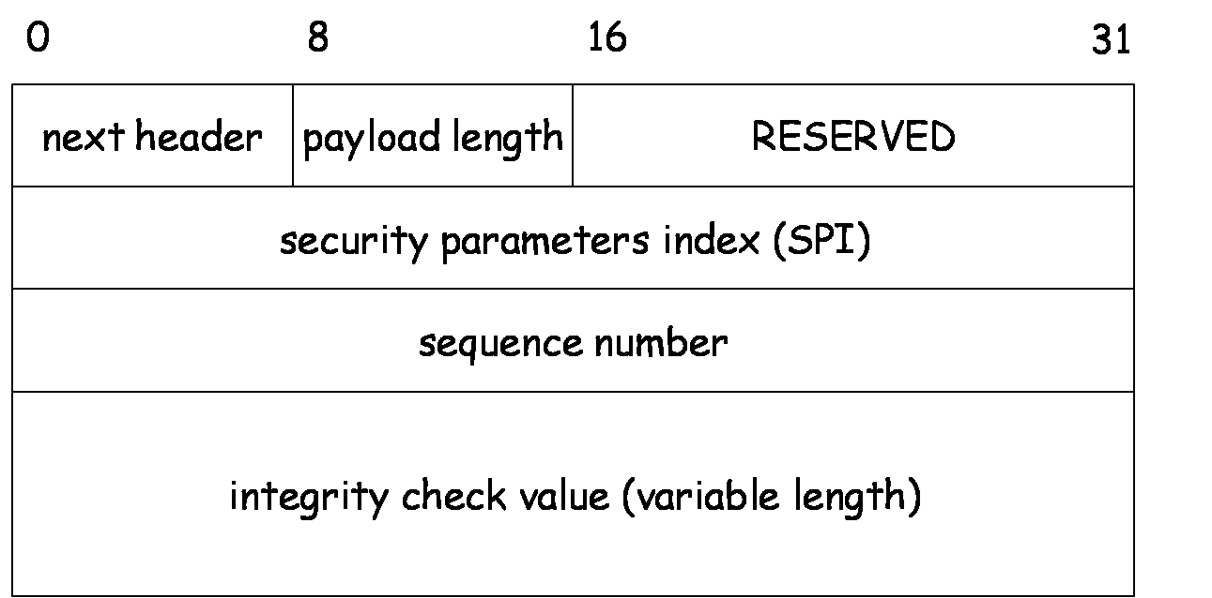
Authentication Header

Slide 31
Resist Message Replay Attack
Sequence number is used with a sliding window to thwart message replay attacks
A
B
C
Given an incoming packet with sequence # s, either
s in A – It's too old, and can be discarded
s in B – It's in the window. Check if it's been seen before
s in C – Shift the window and act like case B

Slide 32
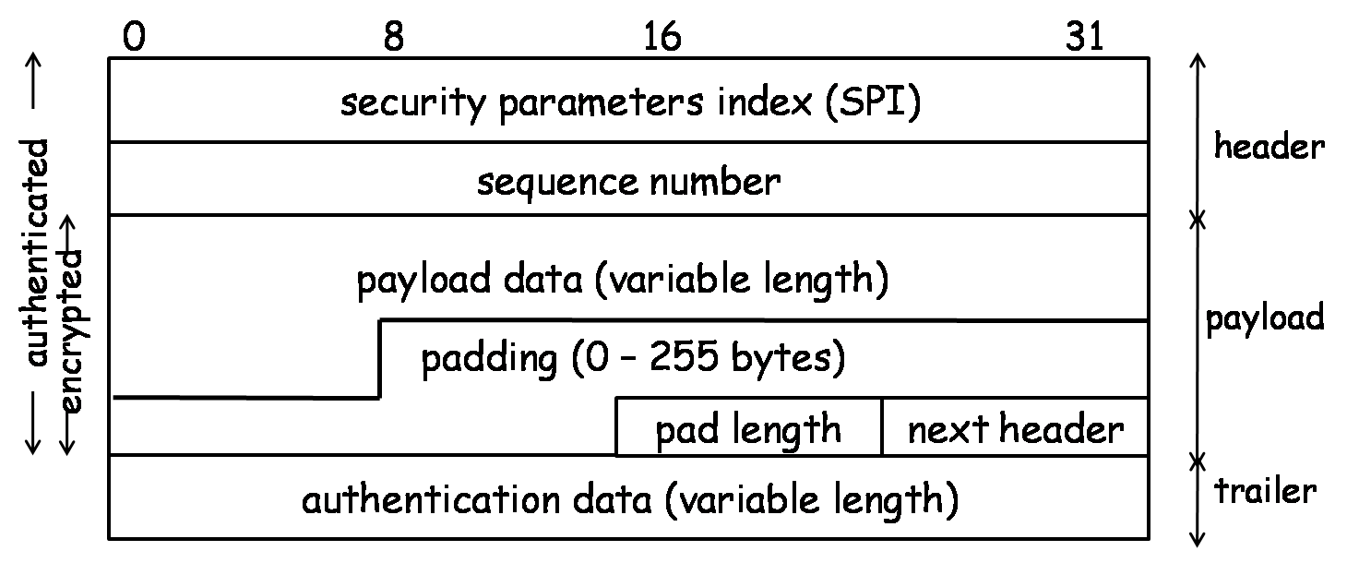
Encapsulated Security Payload

Slide 33
ESP Protocol – Transport & Tunnel
ESP in transport mode:
Original
IP header
ESP hdr
SPI, seqno
Payload
(eg TCP, UDP, ICMP)
ESP
trlr
ESP
auth
MAC scope
ESP in tunnel mode:
Encryption scope
Outer
IP header
ESP hdr
SPI, seqno
Inner
IP header
Payload
(eg TCP, UDP, ICMP)
ESP
trlr
ESP
auth
MAC scope
Encryption scope

Slide 34
Key Determination and Distribution
Oakley key determination protocol (KDP)
Diffie-Hellman Key Exchange + authentication & cookies
Authentication helps resist man-in-the-middle attacks
Cookies help resist clogging attacks
Nonce helps resist message replay attacks

Slide 35
Clogging Attacks
A form of denial-of-service attacks
Attacker sends a large number of public key Y_{i} in crafted IP packets, forcing the victim’s computer to compute secret keys K_{i} = Y_{i}^{X} mod p over and over again
Diffie-Hellman is computationally intensive because of modular exponentiations
Cookies help
Before doing computation, recipient sends a cookie (a random number) back to source and waits for a confirmation including that cookie
This prevents attackers from making DH requests using crafted packets with crafted source addresses

Slide 36
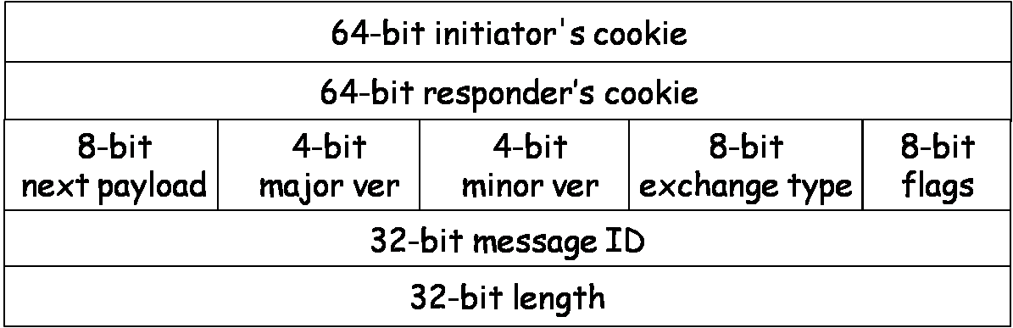
ISAKMP
ISAKMP: Internet Security Association and Key Management Protocol
Specifies key exchange formats
Each type of payload has the same form of a payload header
ISAKMP header

Slide 37
ISAKMP Payload Types
SA: for establishing a security association
Proposal: for negotiating an SA
Transform: for specifying encryption and authentication algorithms
Key-exchange: for specifying a key-exchange algorithm
Identification: for carrying info and identifying peers
Certificate-request: for requesting a public-key certificate
Certificate: contain a public-key certificate
Hash: contain the hash value of a hash function
Signature: contain the output of a digital signature function
Nonce: contain a nonce
Notification: notify the status of the other types of payloads
Delete: notify the receiver that the sender has deleted an SA or SAs
8-bit
Next payload
8-bit
Reserved
16-bit
Payload length

Slide 38
Outline
AAA and Access control
Discretionary Access Control (DAC)
Mandatory access control (MAC)
Role-based access control (RBAC)
Attribute-based access control (ABAC)
Policy-based access control (PBAC)

Slide 39
Access Control and AAA
Definition of Access Control:
Access control refers to the processes and mechanisms used to manage and restrict who can access certain resources and what actions they are permitted to perform.
Key Purpose: Protect sensitive information and prevent unauthorized access to data and systems.
Importance of Access Control in Cybersecurity:
Essential for maintaining data integrity, confidentiality, and availability.
Prevents data breaches, cyber-attacks, and unauthorized data manipulation.

Slide 40
Introduction to AAA
Authentication: Validates user identity to ensure they are who they claim to be.
Authorization: Defines and enforces user permissions based on their verified identity.
Accounting (Auditing): Tracks and records user actions to ensure accountability and detect suspicious activities.
Key Points:
Access control is foundational to cybersecurity, creating a structured method for protecting resources.
The AAA framework is central to managing user access and monitoring actions within a secure system.

Slide 41
Understanding Authentication
Definition of Authentication:
Authentication is the process of verifying the identity of a user attempting to access a system.
Ensures that access is granted only to verified, legitimate users.
Common Authentication Methods:
Password-Based Authentication: Most widely used; relies on user-generated passwords.
Biometrics: Uses unique physical characteristics like fingerprints or facial recognition.
Multi-Factor Authentication (MFA): Combines multiple authentication factors, such as a password and a one-time code sent to a user’s device.

Slide 42
Warmup: Authentication with password +TOTP
Setup Python
python -m pip install cryptography qrcode pillow
Generate Pre-share secret
python gensecret.py
Edit your secret in QR.py and run QR.py to generate the QR code python QR.py
Secure distribute QR code to related party
Edit your TOTP.py code and runTOTP.py to generate TOTP python TOTP.py

Slide 43
Understanding Authorization
Definition of Authorization:
Authorization determines the access rights and permissions a user has once they are authenticated.
Ensures that users have access only to resources necessary for their role or task.
Importance of Authorization in Access Control:
Defines and limits user actions within a system to reduce security risks.
Enforces organizational policies by restricting sensitive data to authorized personnel only.

Slide 44
Understanding Authorization
Example Scenarios:
Role-Based Access: An employee with a “Manager” role may have access to certain reports that a “Regular Employee” does not.
Time-Based Access: Employees may have access to certain resources only during work hours.
Attribute-Based Access: Specific permissions may be granted based on attributes like location or device type
Key Points:
Authorization controls user actions post-authentication, restricting access based on predefined permissions.
Proper authorization ensures security by adhering to the principle of least privilege.

Slide 45
Understanding Accounting (Auditing)
Definition of Accounting/Auditing:
Accounting, or Auditing, involves monitoring and recording user actions within a system.
Provides an activity log that tracks who accessed what resource, when, and what actions they performed.
Purpose of Accounting in Cybersecurity:
Accountability: Ensures users are held accountable for their actions within the system.
Incident Investigation: Logs help detect unauthorized access, unusual activity, or potential breaches.
Audit Trails for Compliance: Supports regulatory requirements by maintaining records of user access to sensitive data.

Slide 46
Understanding Accounting (Auditing)
Purpose of Accounting in Cybersecurity:
Accountability: Ensures users are held accountable for their actions within the system.
Incident Investigation: Logs help detect unauthorized access, unusual activity, or potential breaches.
Audit Trails for Compliance: Supports regulatory requirements by maintaining records of user access to sensitive data.

Slide 47
Understanding Accounting (Auditing)
Role in Compliance:
Demonstrates adherence to regulatory standards (e.g., GDPR, HIPAA) by providing documented evidence of access controls.
Enables organizations to verify that data protection policies are being followed.
Key Points:
Accounting (Auditing) is essential for tracking user activity, enabling accountability and compliance.
Regular audits can identify suspicious activity and ensure adherence to security protocols.

Slide 48
AAA Working Together
Integration of Authentication, Authorization, and Accounting:
Step 1: Authentication – Verifies a user’s identity before granting access.
Step 2: Authorization – Determines which resources the authenticated user can access and what actions they can perform.
Step 3: Accounting – Tracks the user’s actions within the system to ensure proper use and compliance.

Slide 49
AAA in Real-World Applications
Corporate Network Security:
Authentication through passwords and MFA for employees logging into internal networks.
Role-based authorization, where employees only access data relevant to their department.
Accounting via logging systems to monitor and review user actions.

Slide 50
AAA in Real-World Applications
Online Banking:
Authentication includes secure login methods (passwords, biometrics).
Authorization restricts access to the user’s own accounts and limits transaction capabilities.
Accounting tracks transactions and login locations for security and compliance.

Slide 51
AAA in Real-World Applications
Healthcare Systems:
Authentication for healthcare staff, often with secure tokens or biometrics.
Authorization restricts access to patient records based on job roles (e.g., doctors vs. administrative staff).
Accounting ensures audit trails for each access to patient data, supporting regulatory compliance.

Slide 52
Warm-up
Create 2 group on Window OS
Create three users and assign to group
Create some file or folder and implement access control
Login with user and test
Check window events for auditing

Slide 53
Discretionary Access Control (DAC)
Definition of DAC:
Discretionary Access Control (DAC) is a type of access control where the owner of a resource (e.g., file or folder) determines who can access it and what actions they can perform.
DAC is flexible, allowing individual users or resource owners to control access permissions.

Slide 54
Discretionary Access Control (DAC)
Characteristics of DAC:
User-Managed: Access is managed by users who own the resources.
Permissions Flexibility: Owners can share or restrict access at their discretion.
File/Folder-Level Control: DAC is often applied at the file or folder level, giving owners specific control over these resources.

Slide 55
Discretionary Access Control (DAC)
Typical Use Cases:
Personal Settings: Used by individuals on personal computers to control access to files.
Small Business Settings: Ideal for small businesses where owners can manage who has access to shared files and folders.
Collaboration Environments: DAC works well in environments where users need to share files selectively with different team members.
Example of DAC in Practice (google driver?):
In a small business, a team leader might grant certain team members access to project folders but restrict access to sensitive financial documents.

Slide 56
Warmup: DAC in Window and Ubuntu
 DAC_Guide_Windows.md
 DAC_Guide_Ubuntu.md

Slide 57
Mandatory Access Control (MAC)
Definition of MAC:
Mandatory Access Control enforces strict access policies determined by a central authority, not by individual users.
Access is controlled based on classification levels, such as “Top Secret” or “Confidential,” rather than by resource owners.

Slide 58
Mandatory Access Control (MAC)
Characteristics of MAC:
Centralized Control: Policies are set by administrators, not end-users.
High-Security Application: Common in government and military environments where sensitive data must be strictly protected.
Non-Overrideable Policies: Users cannot modify permissions, ensuring strict adherence to security protocols.

Slide 59
Key Differences Between DAC and MAC
Key Differences Between DAC and MAC:
Control of Permissions:
DAC: Permissions are controlled by the owner of the resource (e.g., the user who creates the file).
MAC: Permissions are controlled by the system or administrator based on predefined security policies.
Flexibility vs. Rigidity:
DAC: More flexible, allowing resource owners to freely share or restrict access to resources.
MAC: Much more rigid; users cannot modify or bypass system-enforced access controls.

Slide 60
Key Differences Between DAC and MAC
Key Differences Between DAC and MAC:
Security:
DAC: Less secure in large or sensitive environments due to user discretion in granting permissions.
MAC: Highly secure, as access control is enforced uniformly across the system and is non-negotiable.
Use Case:
DAC: Best for smaller, less sensitive environments where user control and flexibility are important (e.g., small businesses, personal use).
MAC: Best suited for environments requiring stringent security, such as government, military, and industries with sensitive data.

Slide 61
Mandatory Access Control (MAC)
Key Points:
MAC is a strict access control model ideal for high-security environments requiring immovable policies.
Unlike DAC, MAC centralizes access control to ensure consistent and secure access across all resources.

